Slide 1
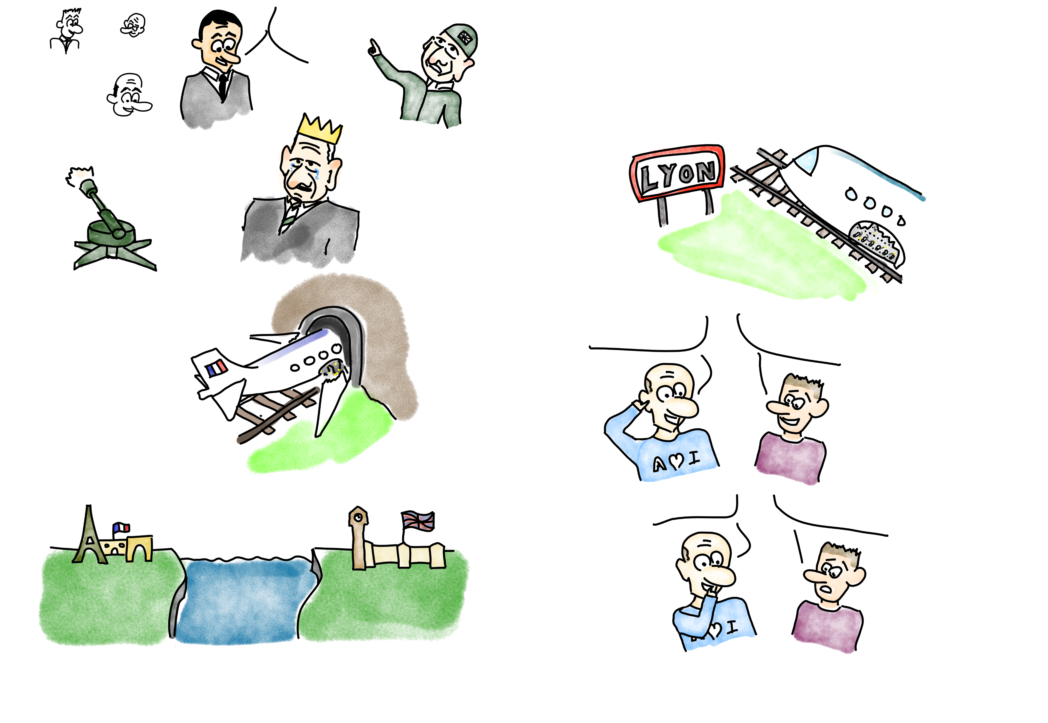
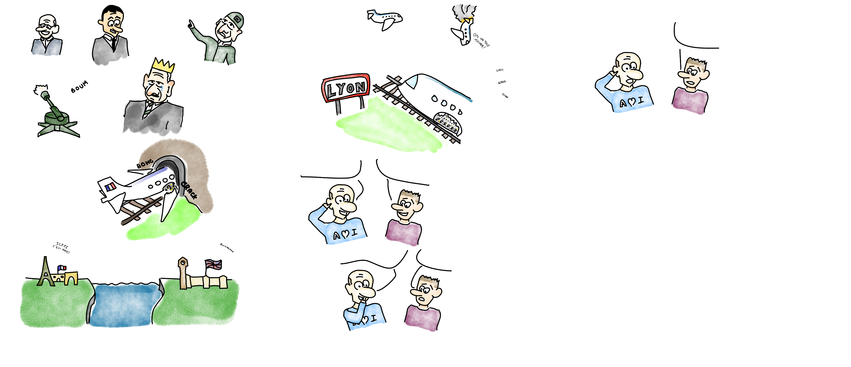

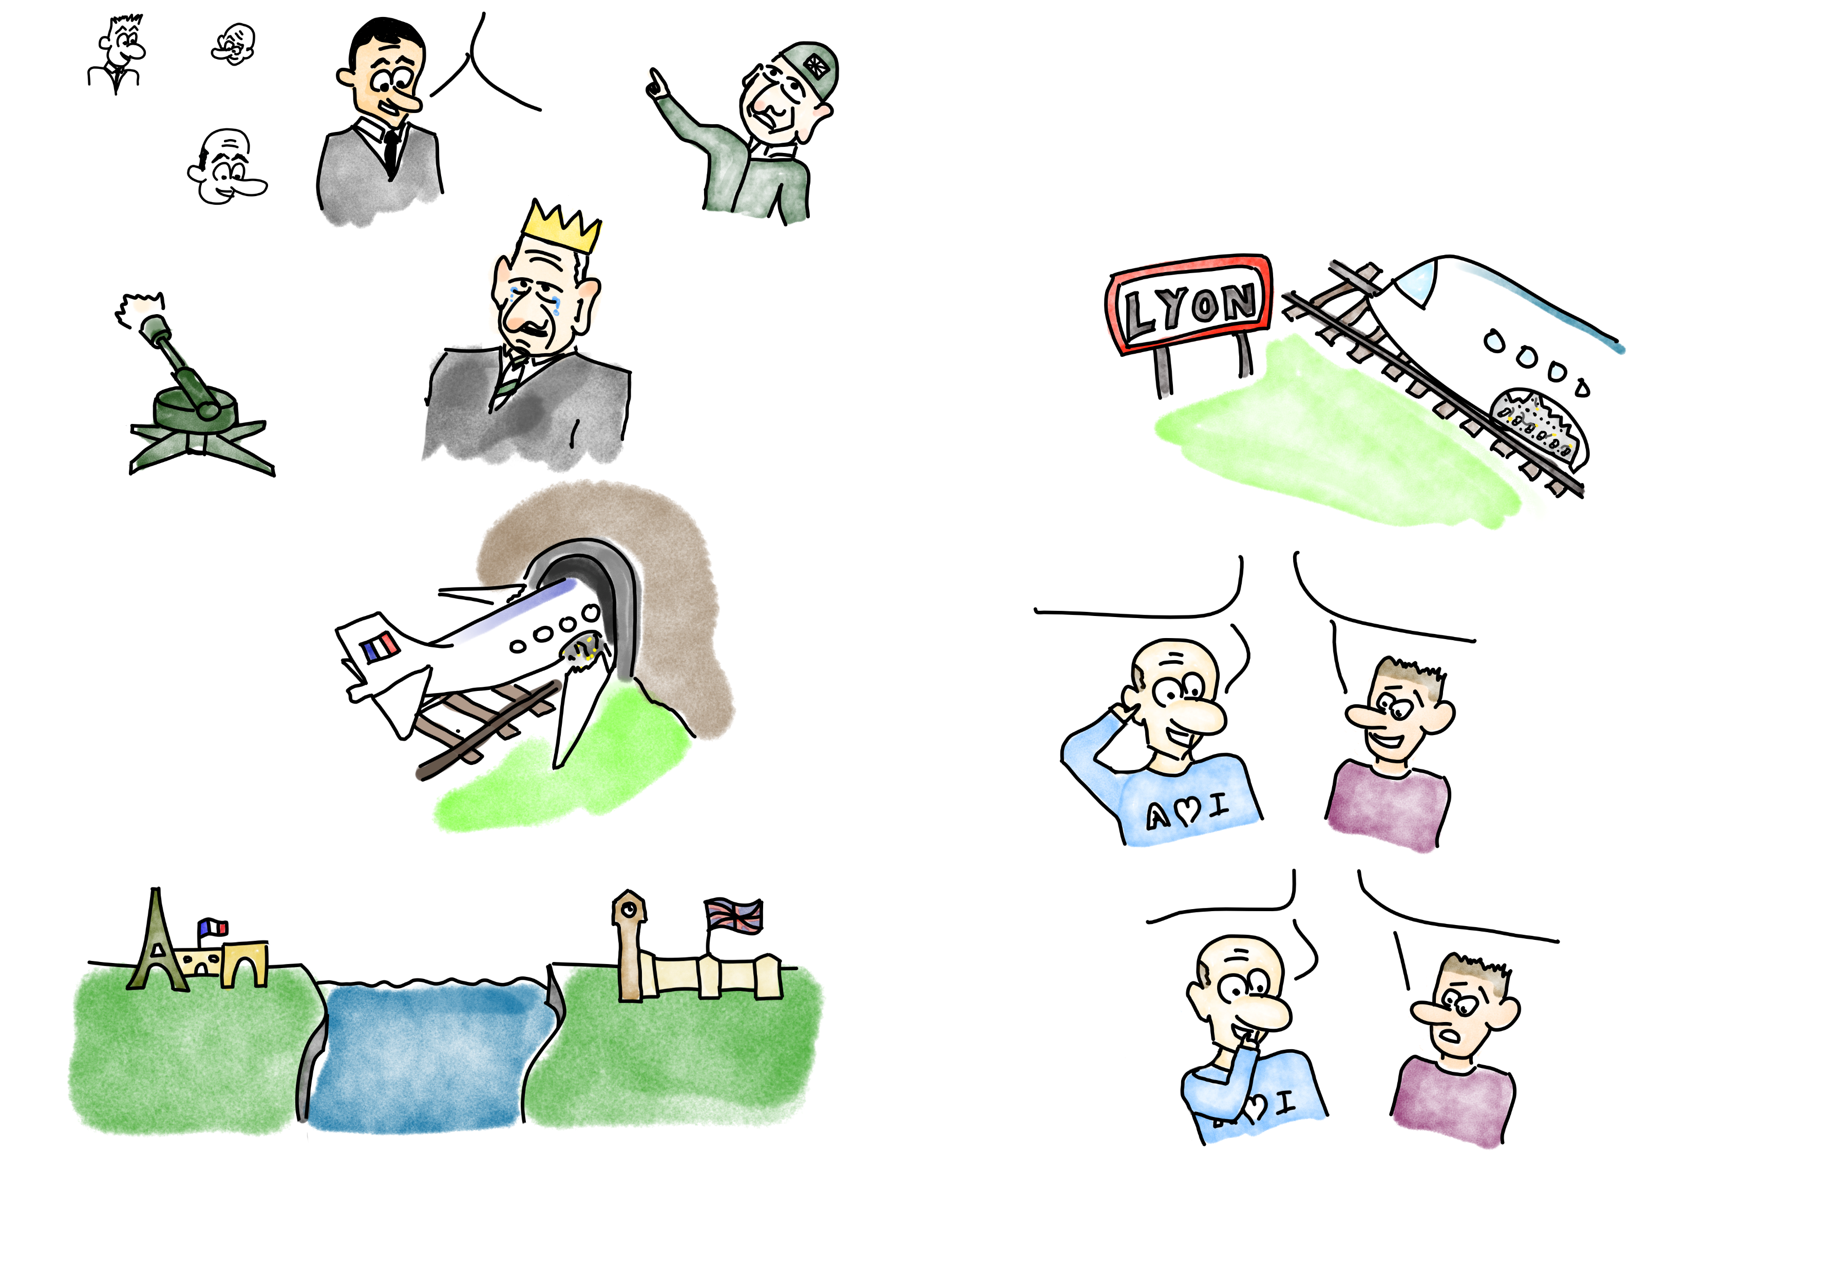

On m'a dit que si je devais accéder à ma base de données Azure, je devais mettre en place un private endpoint. Mais qu'est-ce que c'est un private endpoint ?
Imagine que tu vis dans une grand cité comme Paris et que tu souhaites rendre visite au roi d'Angleterre. Pour cela, tu peux faire comme tous les présidents et prendre un jet pour serrer la paluche de Charles III.
Et bien vois-tu, c'est comme mettre en place un nouveau moyen de transport !
QUE L'ON FASSE AFFRÉTER MON JET. JE DOIS ÊTRE LE PREMIER À FÉLICITER
LE NOUVEAU ROI !
Ça serait comme si tu passais sur Internet pour contacter ta base de données. Le souci c'est que les avions peuvent arriver depuis partout. Pas uniquement depuis Paris.

Slide 2
I was told that if I needed to access my Azure database, I needed to set up a private endpoint. But what is a private endpoint?
Imagine that you live in a big city like Paris and that you want to visit the king of England. To do this, you can do as all presidents do and take a jet to shake the hand of Charles III.
Well, you see, it's like setting up a new means of transportation!
TO HAVE MY JET CHARTERED. I MUST BE THE FIRST TO CONGRATULATE THE NEW KING!
It would be like going on the Internet to contact your database. The problem is that planes can arrive from anywhere. Not just from Paris.

Slide 3
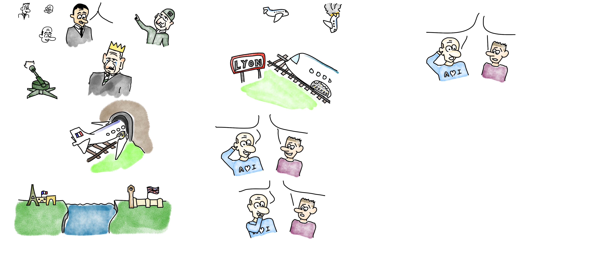

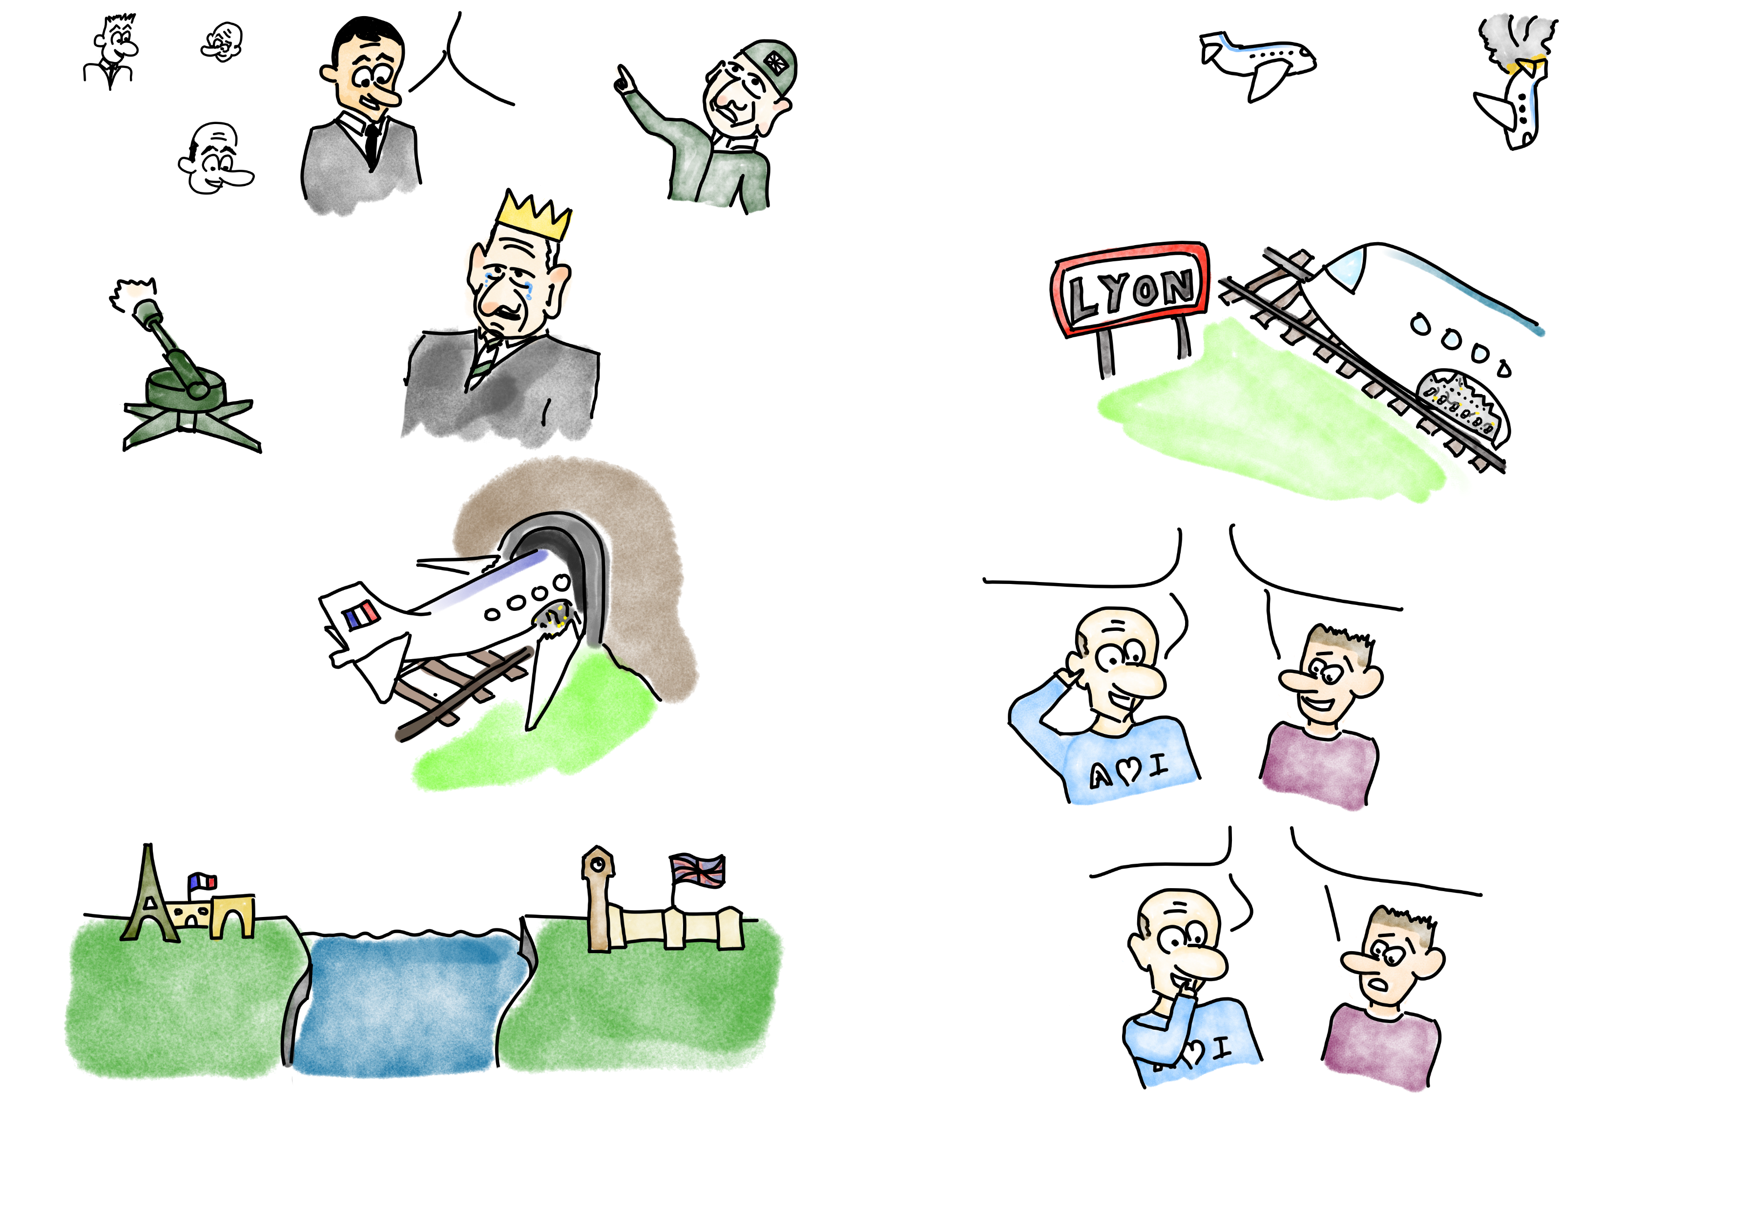



Maintenant, face à ce bazar de trafic aérien, imaginons que nos amis britanniques soient un peu sur les dents.
On fait demi-tour. Ils m'ont l'air un peu tendu !
Ok mais là, plus personne ne peut venir rendre visite au nouveau roi !
C'est pas faux. Il faut trouver un autre moyen. Et c'est là que le private-link fait son apparition.
PAS DE SURVOL DE MON TERRITOIRE !
C'est comme si on interdisait tout appel à la base de données SQL depuis internet.

Slide 4
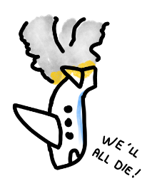
Now, faced with this air traffic mess, let's imagine that our British friends are a bit stressed.
We make a U-turn. They seem to me a little tense!
Ok but now, no one can come and visit the new king!
It's not wrong. We have to find another way. And that's where the private-link comes in.
NO FLYING OVER MY TERRITORY!
It is as if we forbid any call to the SQL database from the Internet.

Slide 5



You can see that it's passing, there was no reason to panic?! We will be there in less time than it takes to say mandate.
We're going to dig a tunnel under the channel to kiss Carlito's ass!
Uh, it already exists!
Ah, well, that's good! Get my jet through that tunnel then!
Like in Mission: Impossible ?
The private-link is like a kind of tunnel allowing to reach a resource directly without going through the internet.

Slide 6

I'm getting there. The private endpoint is like the train station. Indeed, we need a station to get on the train that will take us to our destination and back home. Without it, it would be a bit complicated...
Ok, but that doesn't answer my question: What is a private endpoint?
Mission accomplished, let's go home, I have Brigitte waiting for me for dinner.
I think we've passed Paris.
I will be late. Brigitte, is going to give me a hard time again. And tonight it was fajitas!

Slide 7
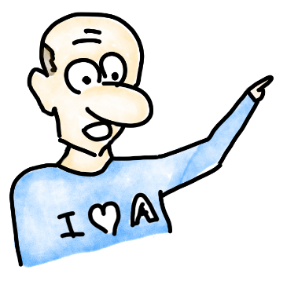
Tunnel under the channel
ICIIII, C’est Paris !*
North Station
Buckingham
Palace
Defense
anti-aircraft
In short, a private endpoint can be compared to this.
* reference to PSG (soccer club) fans

